Slide 1
Computer Networks
Lecture 01

Slide 2
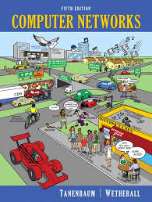

Course Materials
Textbooks
Computer Networks by A Tanenbaum
Data Communications and Networking By Behrouz A. Forouzan
Lecture slides( Will be uploaded regularly !)

Slide 3
What is computer network?
A network is a set of devices (often referred to as nodes) connected by communication links. A node can be a computer, printer, or any other device capable of sending and/or receiving data generated by other nodes on the network. A link can be a cable, air, optical fiber, or any medium which can transport a signal carrying information.

Slide 4
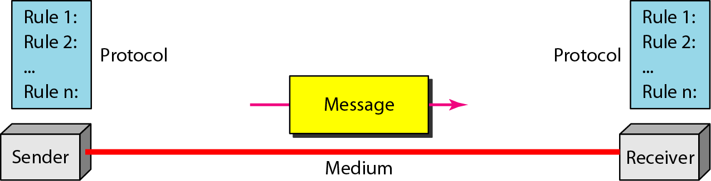
Components of a data communication system

Slide 5
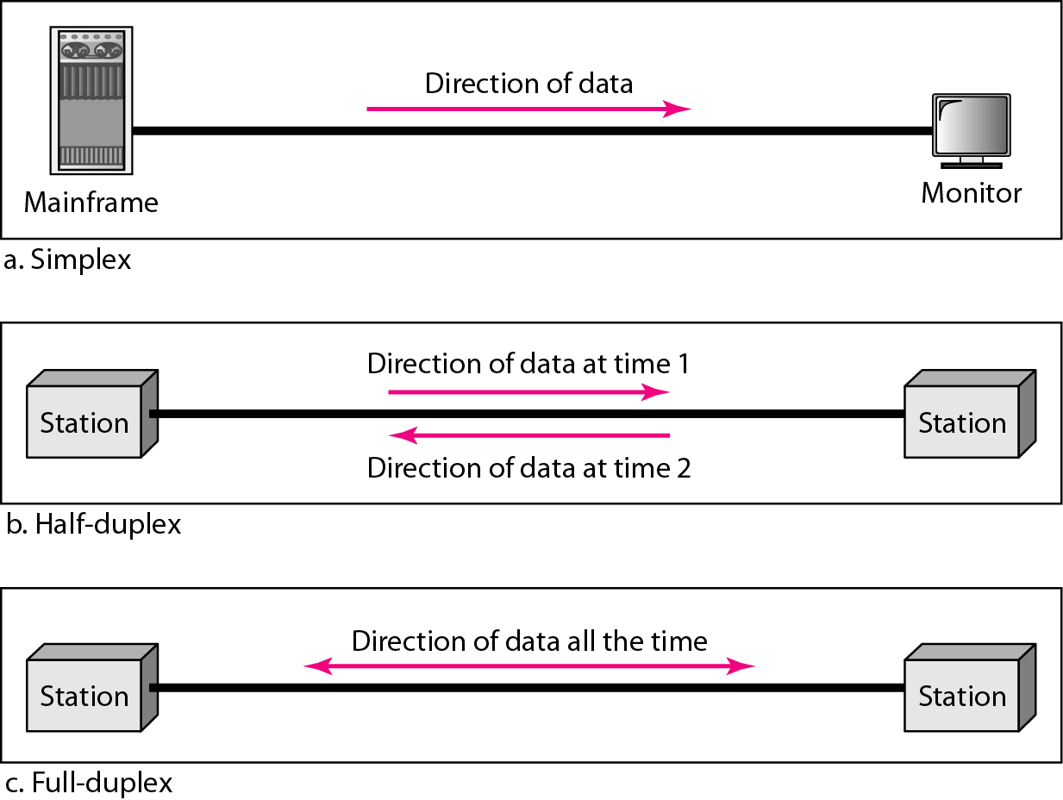
Data flow (simplex, half-duplex, and full-duplex)

Slide 6
Intranet & Extranet
An Intranet is a private local network which is structured within an organization or a company. It’s a private network because no other outsider to that organization can access the intranet. Only the users (may be employees of the company) of the network are allowed to connect the LAN with individual network passwords to access the company’s intranet.
Extranet An extranet is a private network that allows businesses to share information and communicate with authorized external parties.

Slide 7
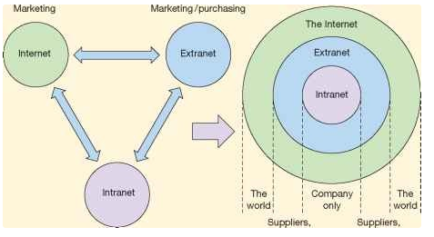
Intranet & Extranet

Slide 8
Benefit of a network
File sharing: A network makes it easy for everyone to access the same file and prevents people from accidentally creating different versions. Printer sharing: With a network, several computers can share the same hardware. For example, you might need a more expensive printer to handle the added workload, it's still cheaper to use a network printer than to connect a separate printer to every computer in your office. Communication and collaboration: It's hard for people to work together if no one knows what anyone else is doing. A network allows employees to share files, view other people's work, and exchange ideas more efficiently. In a larger office, you can use e-mail and instant messaging tools to communicate quickly and to store messages for future reference Shared Internet access: If you have several computers but just one phone line, a network makes using the Internet much easier.

Slide 9
Network Criteria
Performance
Depends on Network Elements
Measured in terms of Delay and Throughput
Reliability
Failure rate of network components
Measured in terms of availability/robustness
Security
Data protection against corruption/loss of data due to:
Errors
Malicious users

Slide 10
How network are categorized?
Architecture
Transmission technology
Scale
Topology

Slide 11
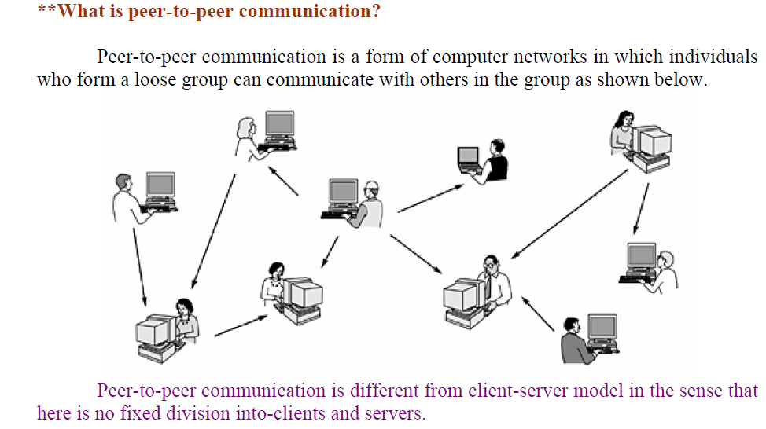
Architecture based type:

Slide 12
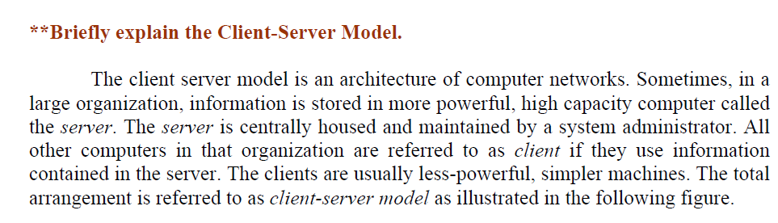
Architecture based type (cont…)

Slide 13
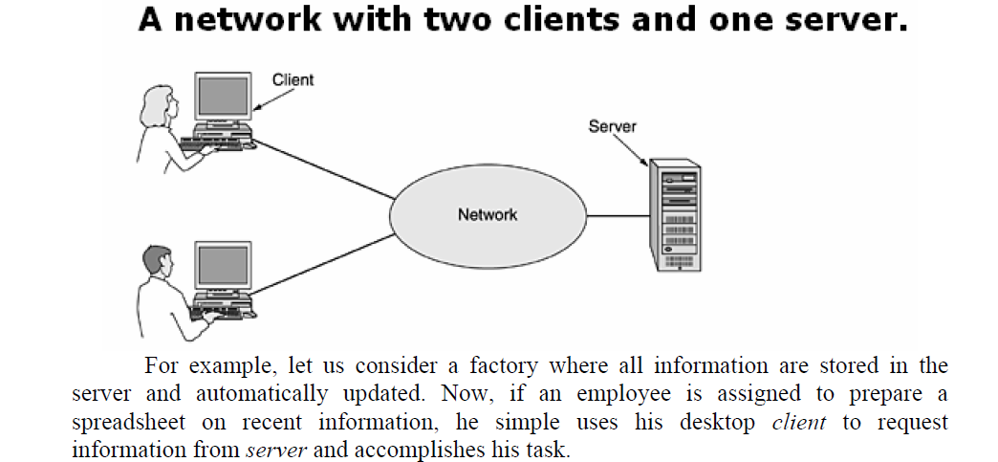
Architecture based type (cont…)

Slide 14
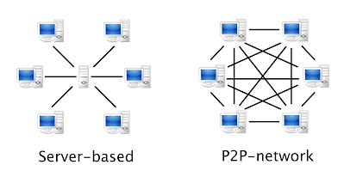
Architecture based type (cont…)

Slide 15
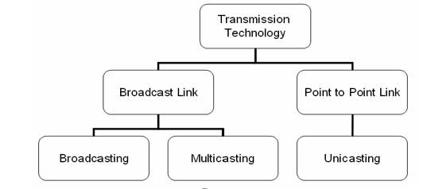
Transmission based type

Slide 16
Transmission based type (cont…)
Unicast is the term used to describe communication where a piece of information is sent from one point to another point. In this case there is just one sender, and one receiver.
Broadcast is the term used to describe communication where a piece of information is sent from one point to all other points. In this case there is just one sender, but the information is sent to all connected receivers.
Multicast is the term used to describe communication where a piece of information is sent from one or more points to a set of other points. In this case there is may be one or more senders, and the information is distributed to a set of receivers (there may be no receivers, or any other number of receivers).

Slide 17
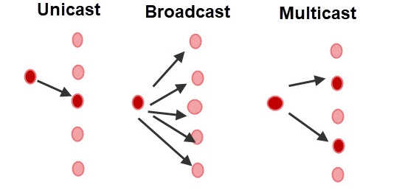
Transmission based type (cont…)

Slide 18
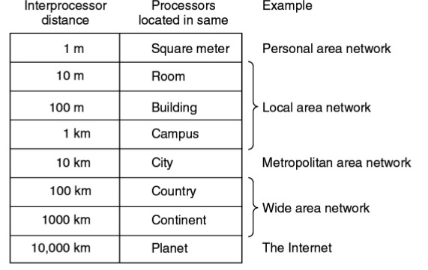
Scale based type

Slide 19
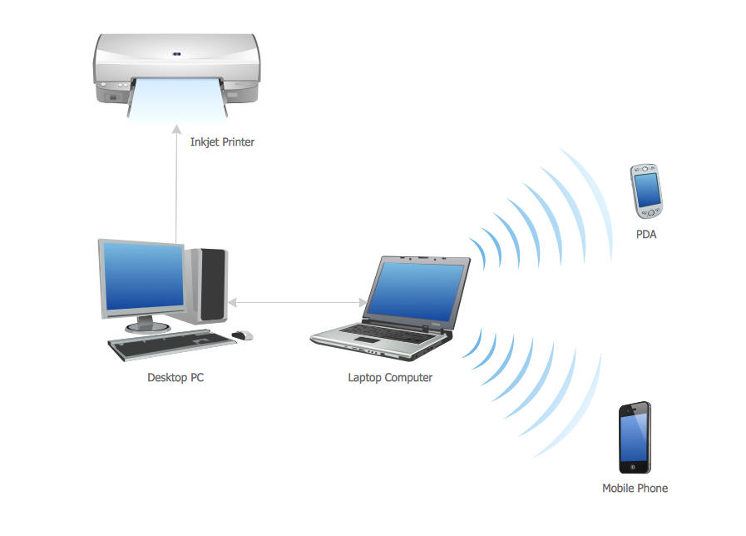
Personal Area Network
A personal area network (PAN) is a computer network for interconnecting devices centered on an individual person's workspace. A PAN provides data transmission among devices such as computers, smartphones, tablets and personal digital assistants.

Slide 20
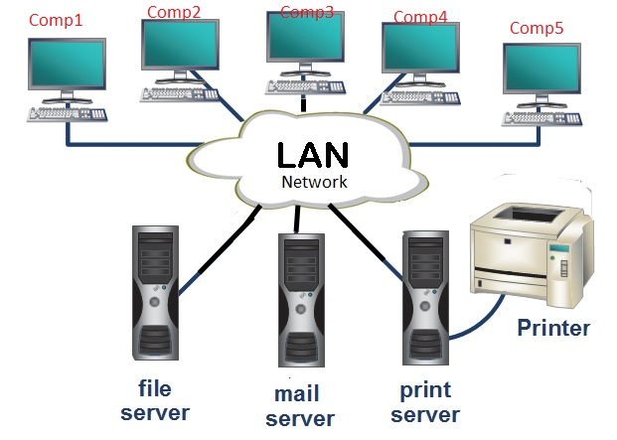
Local Area Network
A local area network (LAN) is a computer network that interconnects computers within a limited area such as a residence, school, laboratory, university campus or office building.

Slide 21
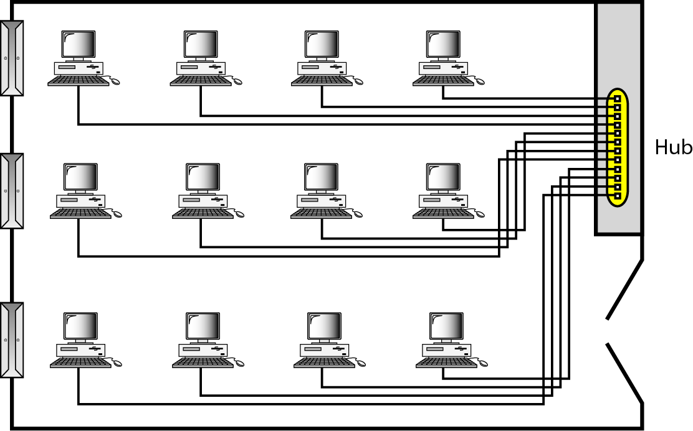
An isolated LAN connecting 12 computers to a hub in a closet

Slide 22
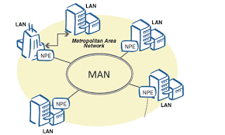
Metropolitan Area Network
A metropolitan area network (MAN) is a computer network that usually spans a city or a large campus. A MAN usually interconnects a number of local area networks (LANs) using a high-capacity backbone technology

Slide 23
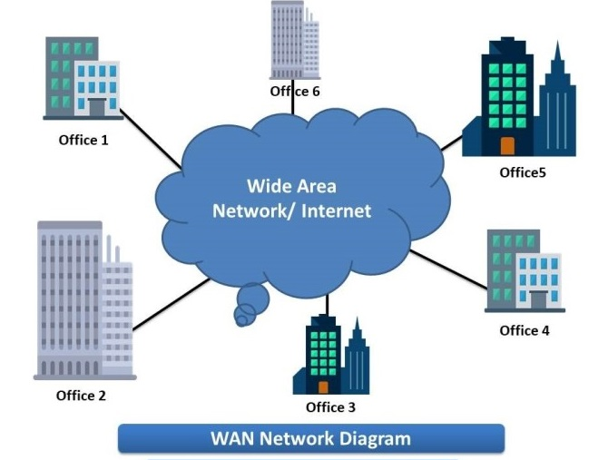
Wide Area Network
A WAN (wide area network) is a communications network that spans a large geographic area such as across cities, states, or countries. They can be private to connect parts of a business or they can be more public to connect smaller networks together.

Slide 24
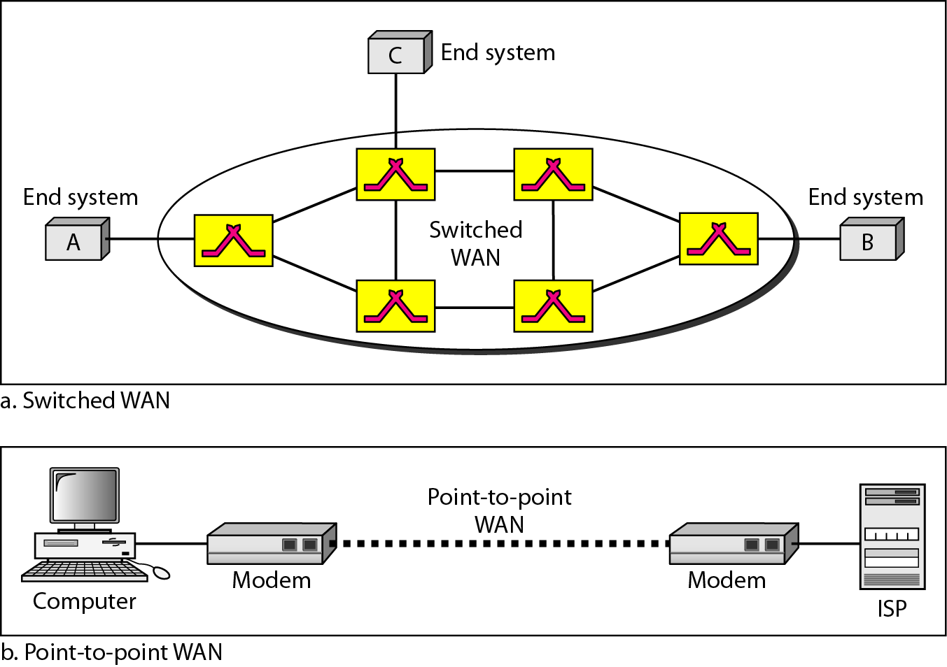
WANs: a switched WAN and a point-to-point WAN

Slide 25
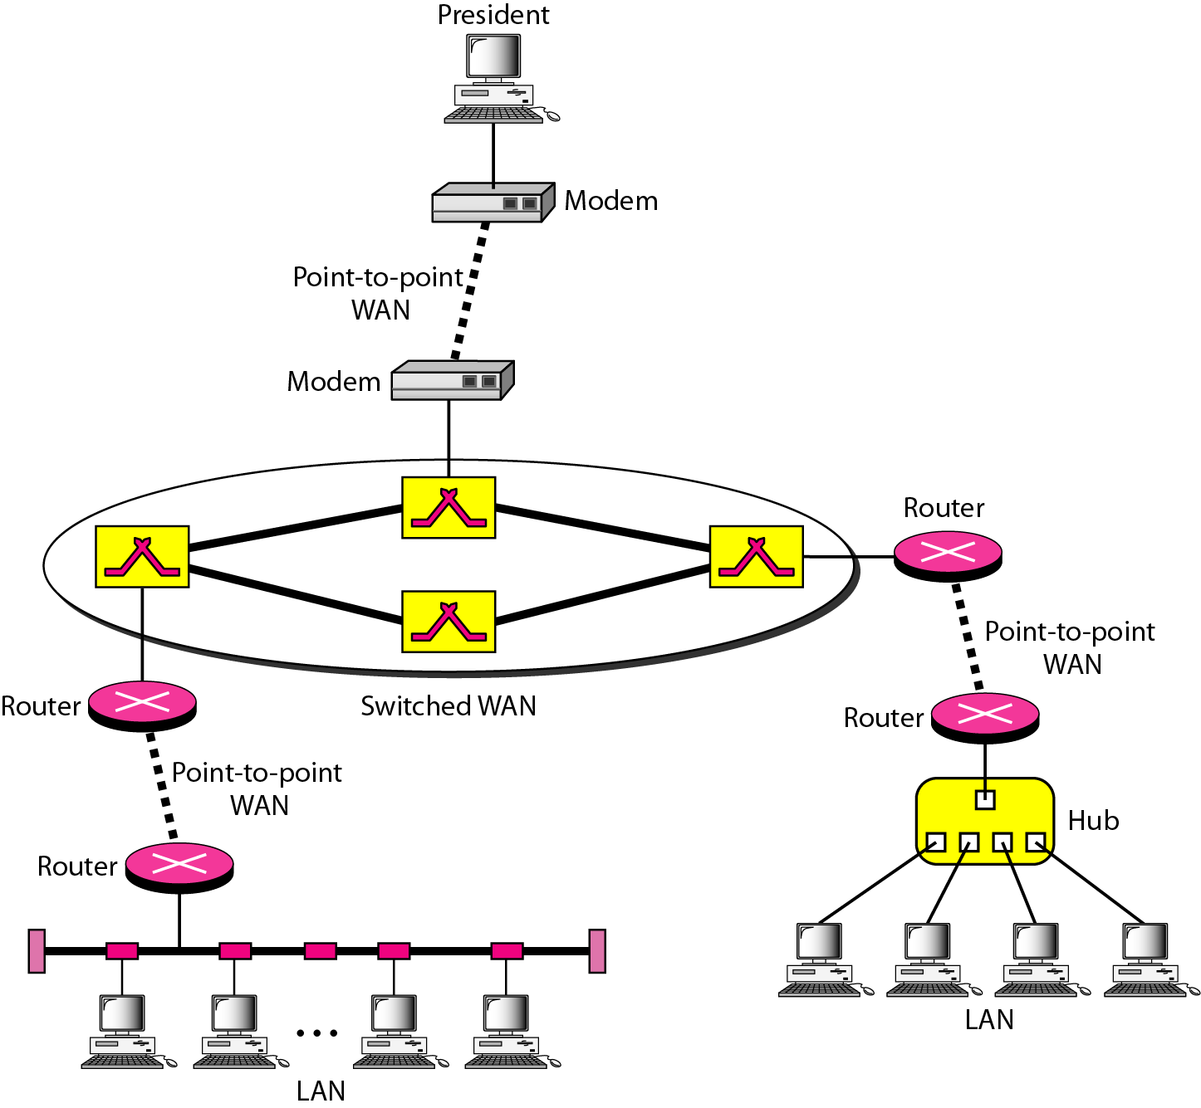
A heterogeneous network made of four WANs and two LANs

Slide 26
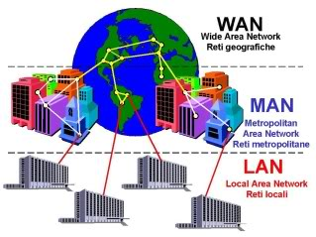

Slide 27
Network Topologies
Topology the logical layout of the cables and devices that connect the nodes of the network.
Network designers consider several factors when deciding which topology or combination of topologies to use:
the type of computers and cabling in place,
the distance between computers,
the speed at which data must travel around the network, and
the cost of setting up the network.

Slide 28
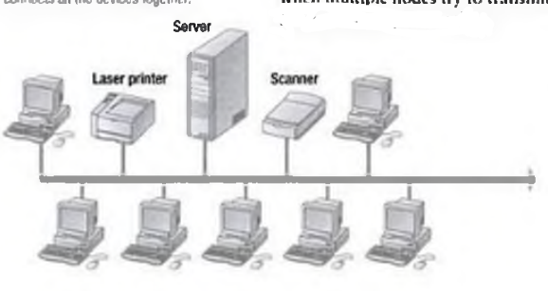
Network Topology: Bus
A bus topology network uses one cable . All the nodes and peripheral devices are connected in a series to that cable.
This topology’s main advantage is that it uses the least amount of cabling of any topology.
A broken connection can bring down all or part of the network.

Slide 29
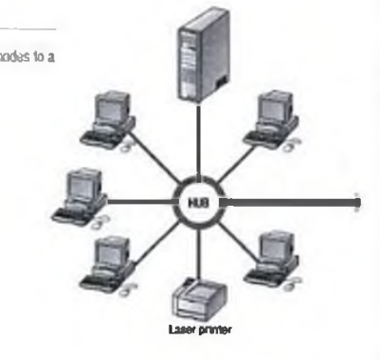
Network Topology: Star
In a star network, all nodes are connected to a device called a hub and communicate through it.
In a star topology, a broken communication between a node and the hub does not affect the rest of the network.
If the hub is lost, however, all nodes connected to that hub are unable to communicate.

Slide 30
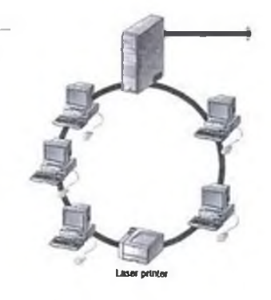
Network Topology: Ring
The ring topology connects the network' s nodes in a circular chain, with each node connected to the next.
The last node connects to the first, completing the ring.
Each node examines data as it travels through the ring.
If the ring is broken, however, the entire network is unable to communicate.

Slide 31
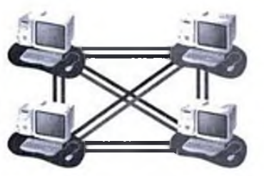
Network Topology: Mesh
The mesh topology is the least-used network topology and the most expensive to implement . ​
In a mesh environment, a cable runs from every computer to every other computer.​
If you have four computers, you must have six cables—three coming from each computer to the other computers. ​
The big advantage to this arrangement is that data can never foil to be delivered; if one connection goes down, there arc other ways to route the data to its destination.

Slide 32
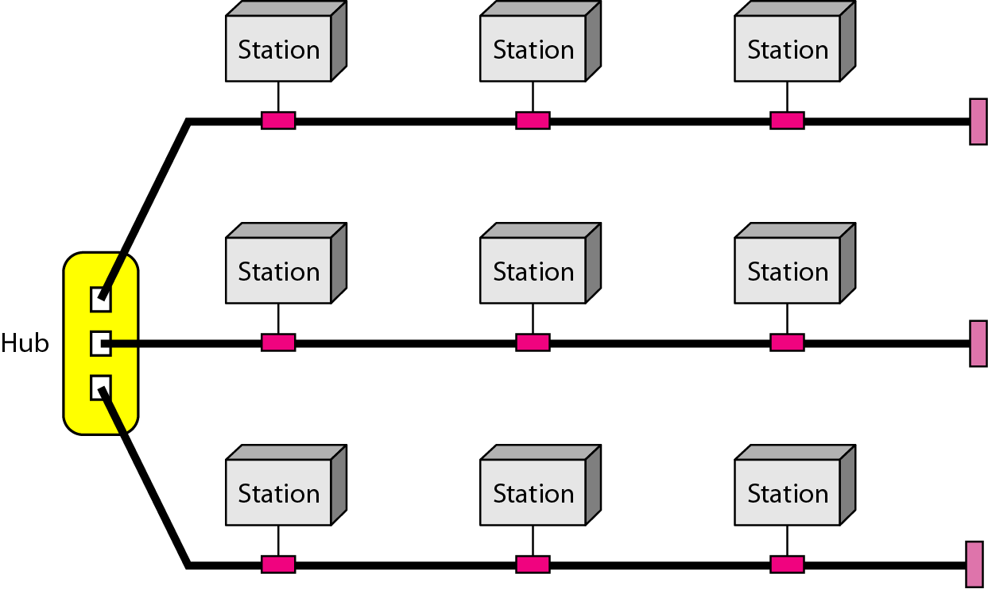
A hybrid topology: a star backbone with three bus networks

Slide 33
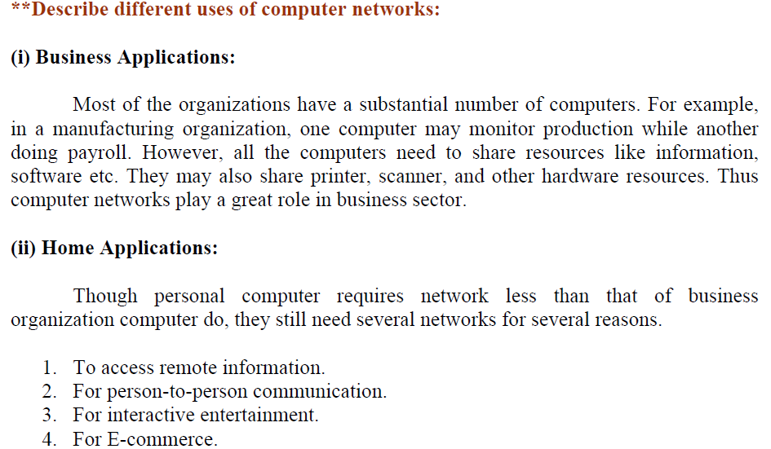
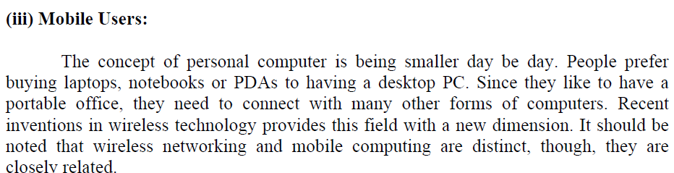

Slide 34
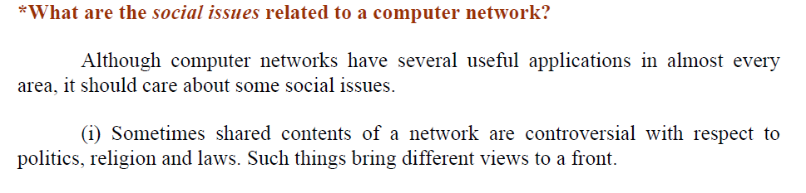
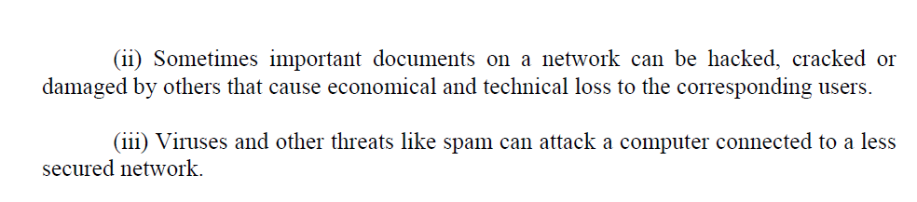

Slide 35
THE INTERNET
The Internet has revolutionized many aspects of our daily lives. It has affected the way we do business as well as the way we spend our leisure time. The Internet is a communication system that has brought a wealth of information to our fingertips and organized it for our use.

Slide 36
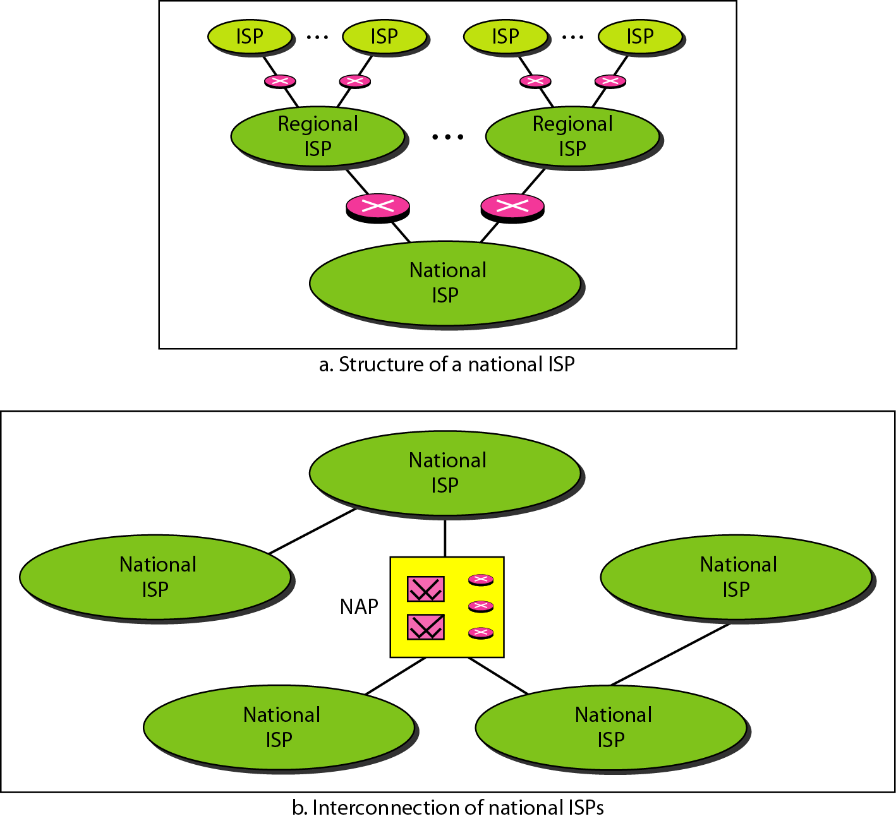
Hierarchical organization of the Internet

Slide 37
Protocol
Protocol: A protocol is a set of rules and standards that basically define a language that devices can use to communicate. It determines what is communicated, how it is communicated and when it is communicated There are a great number of protocols in use extensively in networking, and they are often implemented in different layers. The key elements of a protocol are
Syntax,
Semantics
Timing

Slide 38
Elements of a Protocol
Syntax
Structure or format of the data
Indicates how to read the bits - field delineation
Semantics
Interprets the meaning of the bits
Knows which fields define what action
Timing
When data should be sent and what
Speed at which data should be sent or speed at which it is being received.

Slide 39
Some Network Terminologies
Network Topology
Topology of a network describes the way the computers and the nodes of the network are interconnected. There are a number of possible topologies
Bus Topology
Star Topology
Tree Topology
Ring Topology
Mesh Topology
Links
The physical connections that connects the nodes are known as links. A link may be through a pair of wires, a coaxial cable, an optical fiber or through a satellite.

Slide 40
Basic Terminology
Internetwork: It is a general term describing multiple networks connected together. The Internet is the largest and most well-known internetwork.
Firewall: A firewall is a program that decides whether traffic coming into a server or going out should be allowed. A firewall usually works by creating rules for which type of traffic is acceptable on which ports. Generally, firewalls block ports that are not used by a specific application on a server.

Slide 41
Basic Terminology (cont…)
In a network, any connected device is called as host. A host can serve as following ways:
A host can acts as a Client, when he is requesting information.
A host can acts as a Server, when he provides information.
A host can also request and provide information, is called Peer.
VPN (Virtual Private Network): A VPN allows for information to be securely sent across a public or unsecure network, such as the Internet. Common uses of a VPN are to connect branch offices or remote users to a main office.

Slide 42
Basic Terminology (cont…)
Packet: A packet is a unit of data sent between devices. When you load a web page, your computer sends packets to the server requesting the web page and the server responds with many different packets of its own, which your computer stitches together to form the web page. The packet is the basic unit of data that computers on a network exchange.

Slide 43
“Stay hungry. Stay foolish.”
-Steve Jobs

